Slide 1


Course Title: Programming Fundamentals Course Code: CS141
Assiut University
كلية معتمدة من الهيئة القومية
لضمان جودة التعليم والاعتماد
Prof. Khaled F. Hussain

Slide 2
Basic Elements of C++

Slide 3
Reference
D. S. Malik, “C++ Programming: From Problem Analysis to Program Design”, Cengage Learning

Slide 4




Comments
The program that you write should be clear not only to you, but also to the reader of your program.
Comments are for the reader, not for the compiler.
So, when a compiler compiles a program to check for the syntax errors, it completely ignores comments.
There are two common types of comments in a C++ program
single-line comments
Single-line comments begin with // and can be placed anywhere in the line.
cout << "7 + 8 = " << 7 + 8 << endl; //prints: 7 + 8 = 15
multiple-line comments.
Multiple-line comments are enclosed between /* and */. The compiler ignores anything that appears between /* and */.
/*
You can include comments that can
occupy several lines.
*/

Slide 5










Tokens
The smallest individual unit of a program written in any language is called a token.
C++’s tokens are divided into
Special Symbols
+ - * /
. ; ? ,
<= != == >=
Reserved Words (Keywords)
int, float, double, char, const, void, return…etc.
Identifiers
Consist of letters, digits, and the underscore character (_)
Must begin with a letter or underscore
C++ is case sensitive
The following are legal identifiers in C++:
first
conversion
payRate
Main no reserved word

Slide 6
Whitespaces
المسافات مش بتاثر في الكود اوعي تنسي
Include blanks, tabs, and newline characters
Can be used to make the program readable

Slide 7




Data Types
Simple Data Types
Integral: integers (numbers without a decimal)
char, short, int, long, bool
Floating-point: decimal numbers
float, Range: -3.4E+38 to 3.4E+38 (four bytes)
Double, Range: -1.7E+308 to 1.7E+308 (eight bytes)
Enumeration type: user-defined data type
Structured
Pointers

Slide 8


A type-safety violation (“implicit narrowing”)
// Beware: C++ does not prevent you from trying to put a large value
// into a small variable (though a compiler may warn)
int main()
{
int a = 20000;
char c = a;
int b = c;
if (a != b) // != means “not equal”
cout << "oops!: " << a << "!=" << b << '\n';
else
cout << "Wow! We have large characters\n";
}
Try it to see what value b gets on your machine
لو مش فاكر قولي الي بيحصل هنا قصده ال char اخره255 لو خزن اكتر اي الي يحصل ؟
a
20000
c:
???

Slide 9





A technical detail
In memory, everything is just bits; type is what gives meaning to the bits
(bits/binary) 01100001 is the int 97 is the char 'a'
(bits/binary) 01000001 is the int 65 is the char 'A'
(bits/binary) 00110000 is the int 48 is the char '0'
char c = 'a';
cout << c; // print the value of character c, which is a
int i = c;
cout << i; // print the integer value of the character c, which is 97
This is just as in “the real world”:
What does “42” mean?
You don’t know until you know the unit used
Meters? Feet? Degrees Celsius? $s? a street number? Height in inches? …

Slide 10






Arithmetic Operators, Operator Precedence, and Expressions
C++ arithmetic operators: +,-,?*,/,%
Operators can be unary or binary
Mixed expression:
Has operands of different data types
Contains integers and floating-point
6 / 4 + 3.9
Type Conversion (Casting)
Implicit type Conversion: when value of one type is automatically changed to another type
Cast operator: provides explicit type conversion
static_cast<dataTypeName>(expression)

Slide 11
Mixed Expression
3 / 2 + 5.5 = 1 + 5.5 = 6.5
15.6 / 2 + 5 = 7.8 + 5 = 12.8

Slide 12
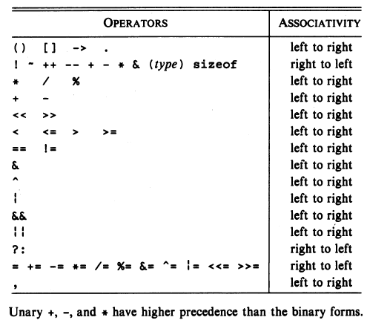




Precedence

Slide 13
Precedence (Cont.)
i + j * k is equivalent to i + (j * k)
-i * - j is equivalent to (-i) * (-j)
+i + j / k is equivalent to (+i ) + (j / k)

Slide 14
Expressions
formulate the following expressions as programs:
ab – c
(m + n) (x + y)
(ab / c)
3n² +2n + 1
n² + 10
(1/2) · n² + 20
2 - (1/n)

Slide 15
The following program illustrates the effect of presence of parenthesis in expressions
main () { float a, b, c, x, y, z; a = 9; b = 12; c = 3; x = a - b / 3 + c * 2 - 1;
y = a - b / (3 + c) * (2 - 1);
z = a - ( b / (3 + c) * 2) - 1;
cout << x << '\n' ;
cout << y << '\n' ;
cout << z << '\n' ; }
Output x = 10.00 y = 7.00 z = 4.00

Slide 16
Assignment Operators
i = 5;
j = i;
k =10*i+ j ;
int i;
float f;
i=72.99f;
f=136;

Slide 17
Assignment Operators (Cont.)
i = j = k = 0; // (i = (j = (k = 0)))
int i;
float f;
f=i=33.3f;
i is assigned the value 33, then f is assigned 33.0 (not 33.3. as you might think).

Slide 18

Assignment Operators (Cont.)
i=i+2;
i+=2;
v +=e adds v to e, storing the result in v
v -= e subtracts e from v, storing the result in v
v*= e multiplies v by e, storing the result in v
v/= e divides v by , storing the result in v
v%= e computes the remainder when v is divided by e, storing the result in v
i+=j+=k; // i+=(j+=k);

Slide 19







string Type
string Type provides operations to find the length of a string, extract part of a string, and compare strings.
Null: a string with no characters
Each character has relative position in string
Position of first character is 0
“Faculty of" position of ‘F’ is 0
The length of “Faculty of" is 10
دا معناه ان ترتيب حرف ال f =0 لان الترتيب بيبدا من 0 مش 1

Slide 20



Allocating Memory with Constants and Variables
Named constant: A memory location whose content is not allowed to change during program execution.
const dataType identifier = value;
const double CONVERSION = 2.54;
const int NO_OF_STUDENTS = 20;
const char BLANK = ' ';

Slide 21
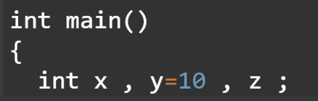





Allocating Memory with Constants and Variables (Cont.)
Variable: A memory location whose content may change during program execution.
The syntax for declaring one variable or multiple variables is:
dataType identifier, identifier, . . .;
double amountDue;
int counter;
char ch;
int x, y;
string name;

Slide 22
Assignment Statement
The assignment statement takes the following form:
variable = expression;
= is called the assignment operator
int num1, num2;
double sale;
char first;
string str;
num1 = 4;
num2 = 4 * 5 - 11;
sale = 0.02 * 1000;
first = 'D';
str = "It is a sunny day.";

Slide 23
Input (Read) Statement
cin >> variable >> variable ...;
int feet;
int inches;
Suppose the input is:
23 7
Next, consider the following statement:
cin >> feet >> inches;
This statement first stores the number 23 into the variable feet and then the number 7 into the variable inches.

Slide 24


Increment and Decrement Operators
Pre-increment: ++variable
Post-increment: variable++
Pre-decrement: --variable
Post-decrement: variable--
What is the difference between the following?
x = 10; x = 10;
y = ++x; y = x++;

Slide 25
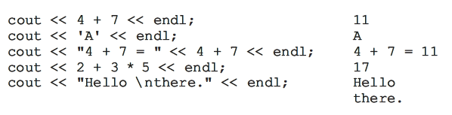
Output
cout << expression or manipulator << expression or manipulator...;
endl manipulator causes the insertion point to move to the beginning of the next line.

Slide 26
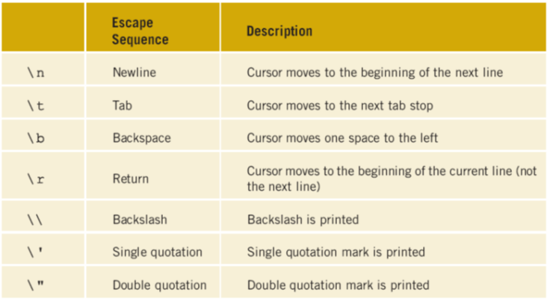




Commonly Used Escape Sequences

Slide 27
EXAMPLE
cout << "Hello there.\nMy name is James.";
or:
cout << "Hello there.";
cout << "\nMy name is James.";
or:
cout << "Hello there.";
cout << endl << "My name is James.";
In each case, the output of the statements is:
Hello there.
My name is James.

Slide 28
EXAMPLE
The output of the C++ statements:
cout << "Count...\n....1\n.....2\n......3";
or:
cout << "Count..." << endl << "....1" << endl
<< ".....2" << endl << "......3";
is:
Count...
....1
.....2
......3

Slide 29
EXAMPLE
The output of the statement:
cout << "The string \"Sunny\" contains five characters." << endl;
is:
The string "Sunny" contains five characters.

Slide 30
Preprocessor Directives
The general syntax to include a header file (provided by the IDE) in a C++ program is:
#include <headerFileName>
For example, the following statement includes the header file iostream in a C++ program:
#include <iostream>

Slide 31
namespace
There are several ways you can use an identifier declared in the namespace std.
One way to use cin and cout is to refer to them as std::cin and std::cout throughout the program.
Another option is to include the following statement in your program:
using namespace std;
You can then refer to cin and cout without using the prefix std::.

Slide 32
string
To use the string type, Include the following preprocessor directive:
#include <string>

Slide 33
Creating a C++ Program
The syntax of the function main has the following form:
int main()
{
statement_1
.
.
.
statement_n
return 0;
}

Slide 34
function main
The body of the function main contains two types of statements:
Declaration statements
int a, b, c;
double x, y;
Executable statements
a = 4; //assignment statement
cin >> b; //input statement
cout << a << " " << b << endl; //output statement

Slide 35
Debugging: Understanding and Fixing Syntax Errors
1. #include <iostream>
2.
3. using namespace std;
4.
5. int main()
6. {
7. int num
8.
9. num = 18;
10.
11. tempNum = 2 * num;
12.
13. cout << "Num = " << num << ", tempNum = " < tempNum << endl;
14.
15. return ;
16. }

Slide 36
This program is very hard to read (syntactically correct)
#include <iostream>
#include <string>
using namespace std;
int main()
{
int num; double height;
string name;
cout << "Enter an integer: "; cin >> num; cout << endl;
cout<<"num: "<<num<<endl;
cout<<"Enter the first name: "; cin>>name;
cout<<endl; cout <<"Enter the height: ";
cin>>height; cout<<endl;
cout<<"Name: "<<name<<endl;cout<<"Height: "
<<height; cout <<endl;return 0;
}

Slide 37
This program is easier to read
#include <iostream>
#include <string>
using namespace std;
int main()
{
int num;
double height;
string name;
cout << "Enter an integer: ";
cin >> num;
cout << endl;

Slide 38
This program is easier to read (Cont.)
cout << "num: " << num << endl;
cout << "Enter the first name: ";
cin >> name;
cout << endl;
cout << "Enter the height: ";
cin >> height;
cout << endl;
cout << "Name: " << name << endl;
cout << "Height: " << height << endl;
return 0;
}

Slide 39


Simple and Compound Assignment Statement
Simple Assignment Statement
Compound Assignment Statement
i = i + 5;
counter = counter + 1;
sum = sum + number;
amount = amount * (interest + 1);
x = x / ( y + 5);
i += 5;
counter += 1;
sum += number;
amount *= interest + 1;
x /= y + 5;

